Slide 1
All about ME Book

Slide 2
MY LIFE AS JANE DOE
My name is Jane Doe. I am a student at the University of Illinois at Urbana-Champaign majoring in political sciences. I am striving to become a future attorney for family and child services. I am 18 years old and I enjoy spending time with family and friends I also enjoy swimming and horseback riding. I hope to gain more independence while living in Nugent Hall. My goals are endless!

Slide 3
ME Book Contents
SECTION 1: DISABILITY SPECIFIC ATTRIBUTE
Slide 7: Letter from MD
Slide 8-9: Medications/dose/frequency
Slide 10: Signs and symptoms for dealing with certain symptoms/or secondary conditions
Slide 11: Immunization record
Slide 12: Allergies
Slide 13: Post-surgical implants
SECTION 2: DAILY SCHEDULE
Slide 16: AM Routine
Slide 17: Bedtime Routine
Slide 18: Toileting Routine
Slide 19: Stretching/walking
Slide 20: Care/directions of any specific appliances/aids

Slide 4
ME Book Contents Continued
SECTION 3: SHOWERING/ BOWEL PROGRAMS
Slide 22: Detailed directions and preferences of shower routine (best if step by step bullets)
Slide 23: Detailed directions if a Bowel Program is utilized
Side 24: Signs and symptoms individual experiences if constipated and ways to alleviate.
SECTION 4: WHEELCHAIR MAINTENANCE/CHARGING INSTRUCTIONS
Slide 26: Provide details of type of wheelchair
Slide 26: Include Serial numbers, and insurance information if maintenance is required
Slide 27: Have picture to show where/how to charge chair. Give written directions also.
Slide 28-29: Have pictures which show how to put chair in manual, and any other important information about chair.
SECTION 5: MISCELLANEOUS (ANYTHING THAT DOESN'T FIT IN ANOTHER COLUMN, BUT WOULD BE HELPFUL INFORMATION)
Slide 31: Instructions/warranties for electronic equipment
Slide 32: Financial Aid/Vocational Rehab counselor contact information
Slide 33: Copy of Letter of Accommodation

Slide 5
DISABILITY SPECIFIC ATTRIBUTES

Slide 6
You can include How-To videos via dropbox.com, google.doc... Include step by step pictures for routines and equipment usage

Slide 7
Include a letter from MD which gives more specific info on you and your disability.

Slide 8
Medications/Dose/Frequency
Medication | Dosage | Frequency
Antispasmodics Colofac Atropine | 2 | Every 6hrs One tablet three times a day One tablet every 4 to 6 hours
Anticonvulsants Phenytoin Phenobarbital | 1 | One tablet two or three times a day One tablet one to three times a day
Anticholinergics ipratropium bromide oxitropium bromide | 1 | Inhale 2-4 puffs 3-4 times daily Inhale 2 puffs 2-3 times daily

Slide 9
If you want to set up your meds a week at a time, bring a pill container. - A PA can set it up for you if you want them to.

Slide 10
Signs and symptoms for dealing with certain conditions from your disability ~ for example, Autonomic Dysreflexia:
Explain the signs and symptoms that you have.
How will someone unfamiliar to you know you are having such symptoms? List treatments.

Slide 11
Immunization Record
What shots have you had?
When did you receive them?
Note: Please include immunization records

Slide 12
List allergies to medicine or food, what happens if you’re exposed to allergen, and treatment if exposed.
For example:
Allergic to peanuts
Symptoms include vomiting, abdominal pain, constriction of airways
Treatment involves taking individual to hospital.
Allergic to penicillin
Symptoms include hives, skin rash, itchy skin, congestion, mouth swelling, anaphylaxis
Treatment of rashes and hives can be treated with an antihistamine. Treatment of anaphylaxis requires an injection of epinephrine.

Slide 13
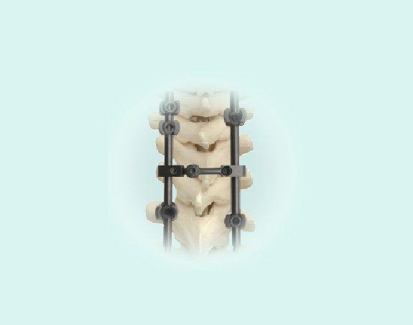
Do you have any post-surgical implants?
Rods
Fusing of bones
Plates
Screws
Pacemaker
Baclofen Pump

Slide 14
DAILY SCHEDULE
NOTE: The more specific the better; include any cautions for transferring… if you have a rod or something that would limit your flexibility.

Slide 16
AM ROUTINE
Use urinal as soon as I wake-up
Put on my socks, AFOs and shoes
Assist with stand-pivot transfer to chair (lift can be used if preferred)
Hand me my shirt and deodorant
While I’m putting on my shirt/deodorant, please clean my glasses with soap and warm water.
I’d then like to sit on the commode, so I’ll need to transfer again.
I will need assistance with my hygiene when I tell you I’m finished.
I can brush my own teeth, but I need you to put the toothpaste on.
Please hand me my morning medication out of the pill box and give me some water.
I will then Shave
I will ask for your help with getting my books and stuff for class.
If the weather is bad, I may ask for help with a jacket or to cover my joystick in a bag.
If you could please clean my bi-pap mask with warm water and soap.
Then I will leave out for breakfast.

Slide 17
BEDTIME ROUTINE
Hand urinal if necessary, when I'm done, please empty, then clean with warm soapy water.
On shower nights- I'll need to transfer to my shower chair.
I need help taking off my shoes, AFO’s, socks and pants, but I can take off my shirt.
Put bar down on shower chair.
I can wash parts of my upper body and hair, but I need help with my back and lower body.
I need assistance drying off. If doing a stand-pivot transfer, I'll need my shoes, AFO’s, socks put on.
I need help transferring into bed, please take off my shoes, AFO’s, and socks.
Hand me a shirt if I ask you for it to sleep in.
Please check if my bi-pap needs distilled water added, then hand me the mask.
Passive ROM/stretching.
I will tell you what clothes I’ll be wearing tomorrow so you can get them from my wardrobe.
Plug in Cell phone (put on night stand), plug in electric chair, check alarm clock setting, throw clothes in hamper, place call pad/urinal where I can reach it.
Turn off lights and shut door on way out.

Slide 18
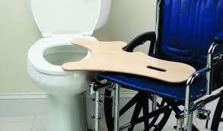
TOILETING ROUTINE
While in chair pull my bottom garments down
Transfer to toilet by pivot lifting, transfer board, or using the mechanical lift
Have PA step out of bathroom and return when called for
Clean me using wet wipes
Transfer back to chair
Pull up my bottom garments
Wash my hands

Slide 19
STRETCHING/WALKING
Put together walker
Power off chair
Have PA help me stand and grab onto walker
Walk up and down hallway (Put how many times)
List the types of stretches to be done.
Include the amount to do per day

Slide 20
Transferring to Toilet Using the Lift
Get remote
Use remote to take lift into the bathroom and position above me
Scoot me forward in my chair
Place support hooks under my upper thighs
Position body support low on hips and underneath my armpits
Before you begin raising me, let me know so i am not startled
Propel lift over commode then lower down and make sure i am positioned well on the toilet seat
Ask me if i am comfortable and balanced
Remove support hooks from thighs and move lift out of the way
I will call you back into restroom when I am done
Propel lift back over me
Place support hooks on my upper thighs
Position body support low on hips and underneath my armpits
Before you begin raising me, let know so I am not startled
Propel me over my wheelchair and then lower in place
Remove support hooks from thighs and move lift out of the way
Propel lift out of bathroom to docking station and put remote back where you found it

Slide 21
CARE DIRECTIONS OF APPLIANCES
Appliances include Catheters, braces, bi-pap, c-pap, g-tube, j-tube, suctioning equipment, O2 concentrator, etc.
Include how to clean each appliance that you use

Slide 22
SHOWER/BOWEL PROGRAMS

Slide 23
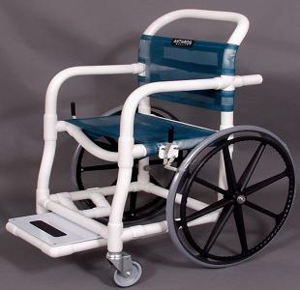
Shower Routine
remove clothing prior to transfer
transfer from wheelchair to shower chair
lock shower chair
secure with leg straps and seat belt
turn on shower to warm
use gentle spray on showerhead and spray over body from head first down to legs
use wash cloth to gently wash skin and body
surface with soap
rotate shower chair to wash when necessary
turn off shower and dry head and body with
separately towels, respectively
leave towel on head and body, and lay additional
dry towel on wheelchair
transfer from shower chair to wheelchair
dress resident when on wheelchair

Slide 24
Bowel Program
1. Get positioned on the left side of the body on a bed
2. Place 2 blue pads behind the buttocks
3. Put on gloves, lubricate index finger, and begin digital stimulation
4. When all stool is removed, insert 2 suppositories as far as you can into rectum along bowel wall
5. Continue to wait on the left side of the body on the bed for 15-45 minutes
6. Transfer to toilet or commode
7. Sit for 15-20 minutes along digital stimulation 2-3 times if necessary
8. Clean

Slide 25
Symptoms and signs of constipation
smaller bowel movement for a few days
abdominal cramps or pain
decreased appetite
small liquid or soft stool in underwear
Treatment
increase fluid intake
increase fiber intake

Slide 26
Wheelchair Maintainence/Charging Instructions

Slide 27
Wheelchair Maintenance
Type: 2800GTBL-RCL Power chair
Serial number: 234FSD97N - 384B - WER8455
Insurance Information:
Name: Jane Doe
Address: 123 Main Street
Insurance Company: Medicaid
Insurance Contact Information:
Insurance Policy Number: ##########

Slide 28
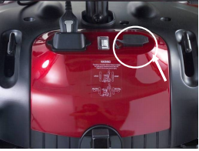
Wheelchair Charging Instructions
Position wheelchair new wall outlet.
Turn off wheelchair with power button.
Slide cover of charger plug.
Extend the charger power cord and plug it into the wall outlet.
Charge for 8-14 hours.
When fully charged, remove cord from plug.

Slide 29
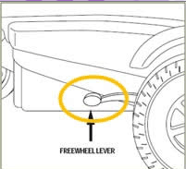
Putting Chair in Manual
Push the freewheel lever to "NEUTRAL" position

Slide 30
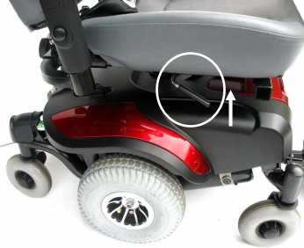
Adjusting Arm Rest
Adjusting the Seat
Loosen the knobs
Slide the armrests in or out to the desired width.
Tighten the knobs
Pull lever up
move seat to desired position
pull lever down

Slide 31
Miscellaneous Information

Slide 32
Include Instructions/warranties for electronic equipment

Slide 33
Financial Aid/Vocational Rehab counselor contact information

Slide 34
Sample Letter of Accommodation
To whom it may concern:
Jane Doe is eligible to receive the following academic accommodations:
1) Extended time for 2x length of exam
2) A scribe for class notes and exams
3) Ability to take exam on alternate day if more than one exam is scheduled.
4) Extended time on assignments with pre-approval from professor.
I thank you for considering the above accommodations. I'll be speaking with you to answer/clarify any questions you might have.

